Slide 1
E-COMMERCE ANALYTICS
Prepared by
P.GNANA GANESH
2211CS010478

Slide 2
Introduction
Theory:
E-commerce analytics is the process of collecting, analyzing, and interpreting online retail data. It helps businesses understand customer behavior, identify trends, optimize operations, and make data-driven decisions.

Slide 3
Importance of analytics
Understand customer behavior
Optimize marketing strategies
Improve product recommendations
Enhance customer experience
Boost conversion rates

Slide 4

Python source code

Slide 5
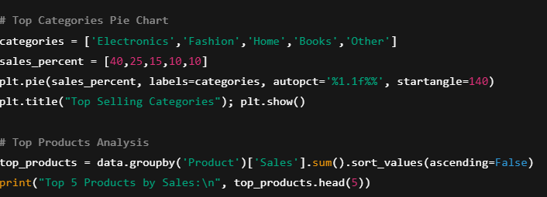

Slide 6
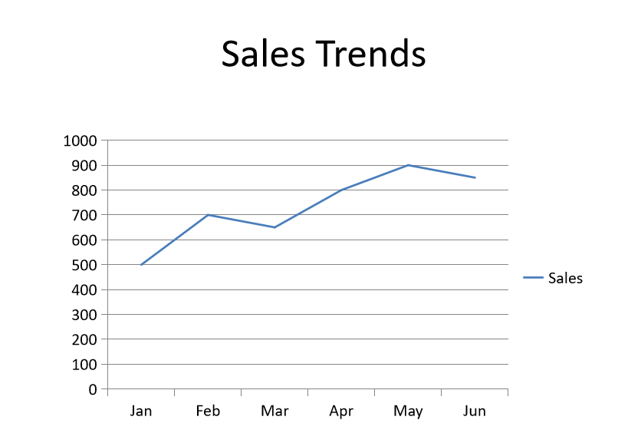
Outputs

Slide 7
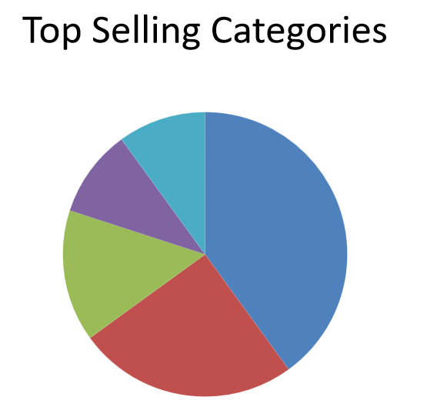
Pie-chart

Slide 8
Tools Used
Google Analytics
Python (Pandas, Matplotlib, Seaborn)
Power BI / Tableau
Excel / SQL
Shopify / Amazon dashboards

Slide 9
Challenges
Data privacy & security
Integrating multiple data sources
Real-time data processing
Maintaining data quality

Slide 10
Conclusion
E-commerce analytics empowers businesses to make data-driven decisions by providing actionable insights from customer behavior, sales trends, and product performance. It helps companies optimize marketing strategies, reduce costs, and target the right audience more effectively. By analyzing key metrics such as conversion rates, average order value, and cart abandonment, businesses can enhance customer experience and improve retention.

